Slide 2
sharing the Cross with wifi
http://BibleBox.org
@theBibleBox
Facebook.com/TheBibleBox
https://plus.google.com/+BibleboxOrg

Slide 3
A portable, self powered wifi router which shares digital files to users of wifi enabled devices.

Slide 4
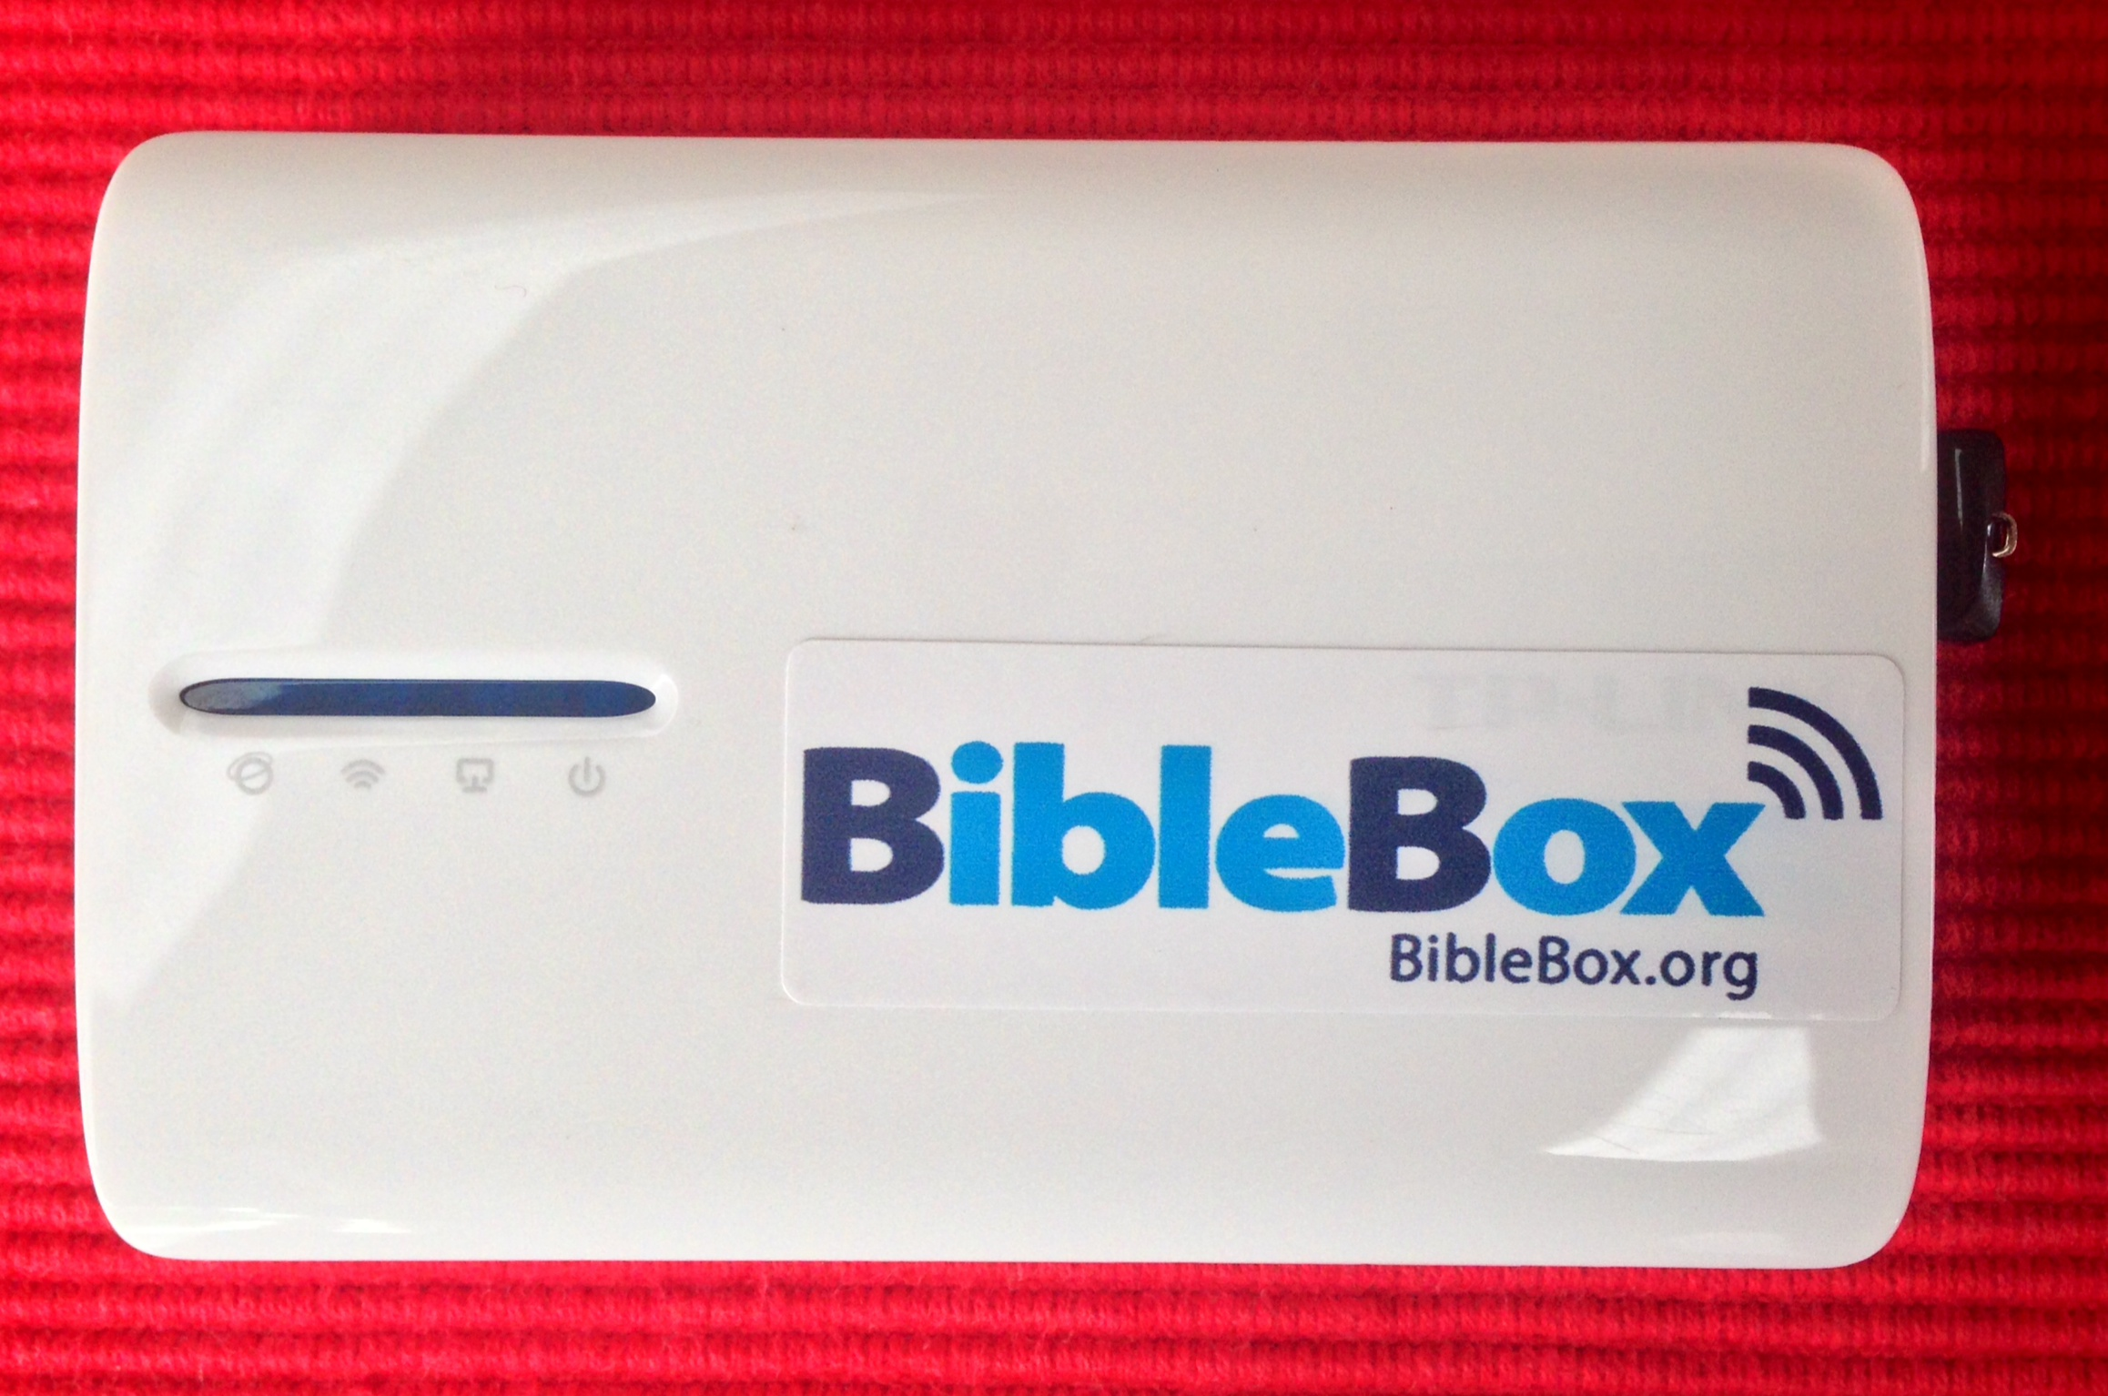
TP-Link MR3040 wireless router
Sandisk Cruzer Fit micro USB drive
OpenWRT firmware upgrade
Piratebox/Librarybox install files
BibleBox customisation files……….and sticker!

Slide 5
Technical specs:
Wireless N speed up to 150Mbps
2000mAh battery (4 - 5 hours)
1 x 10/100Mbps WAN/LAN port,
USB 2.0 port, micro USB port for battery charging
94g (3.3 ounce) 100 x 62 x 16 mm
internal antenna

Slide 6
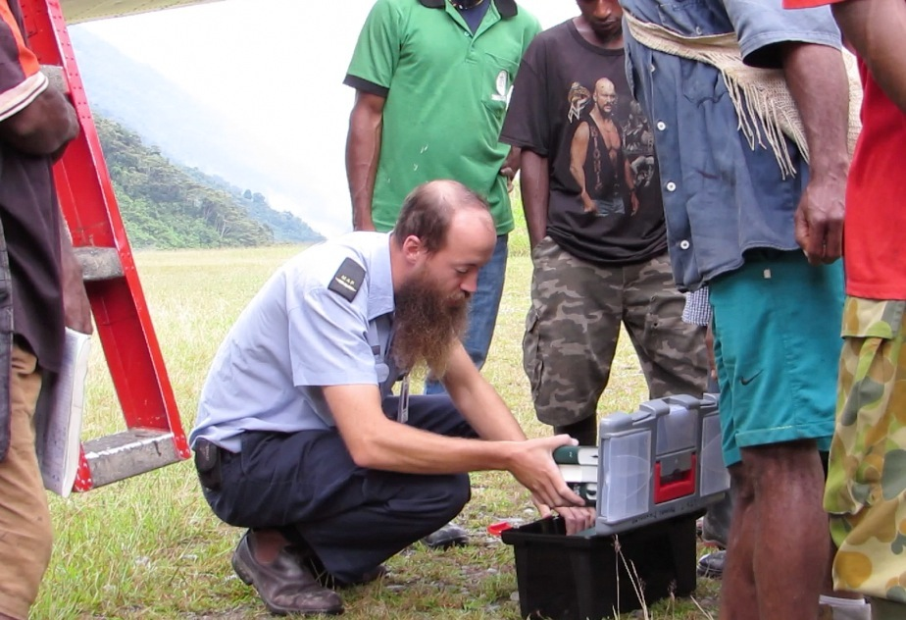

Slide 7
Pilot’s Bible Box
MAF Pilot Matt Painter started distributing Bibles and resources from his aircraft in remote Papua New Guinea
The box in the back of the aircraft began being called the Bible box
Bible, Bible Dictionary, Bible Handbook
MAF pilots continue to sell resources from their Bible box

Slide 8
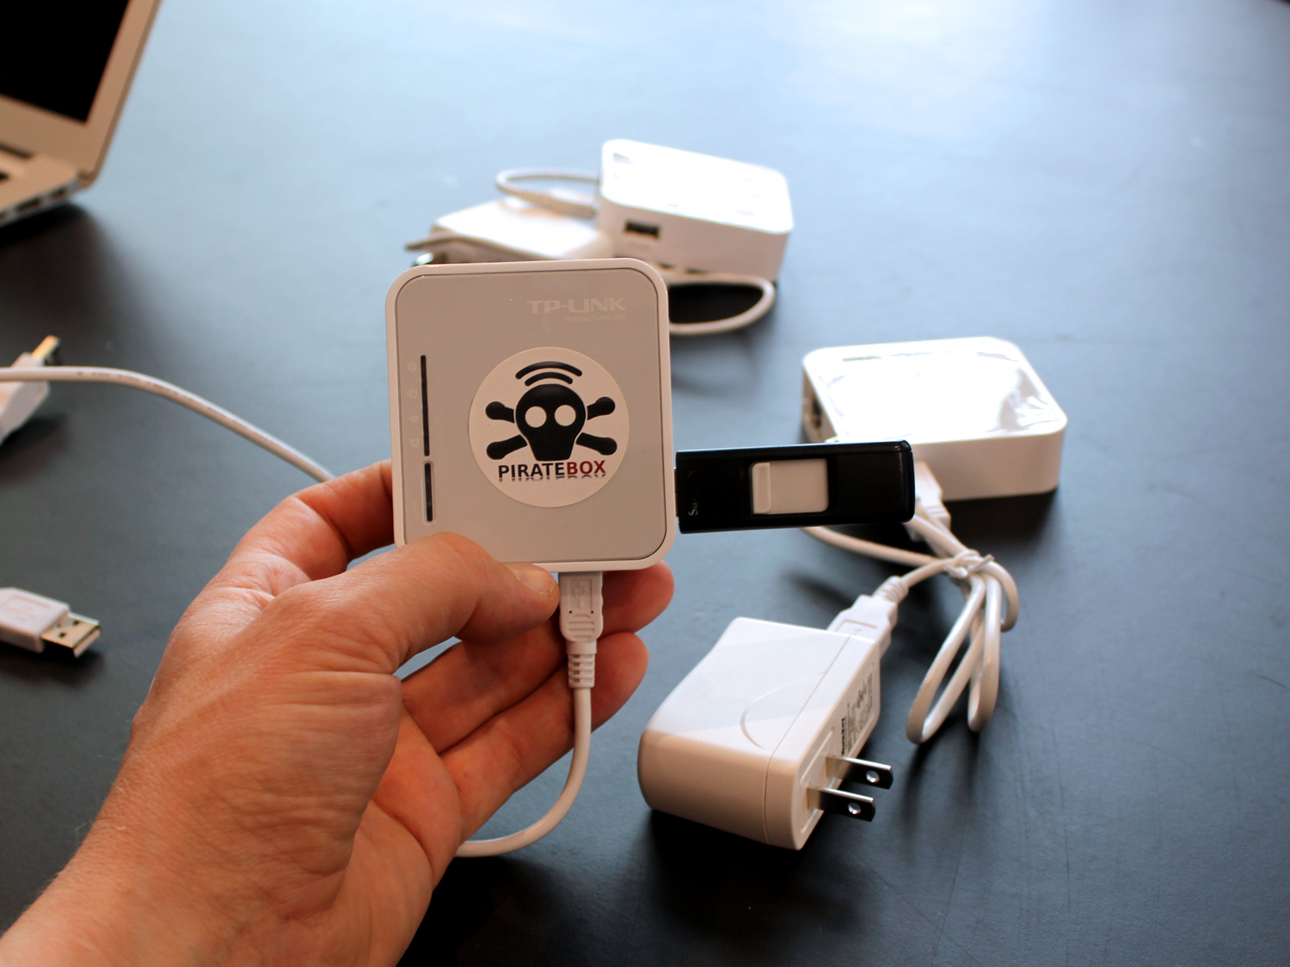
Piratebox

Slide 9
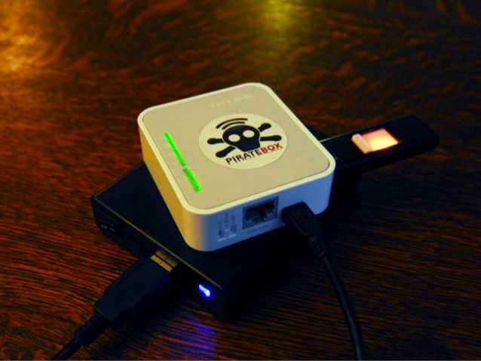

Slide 10
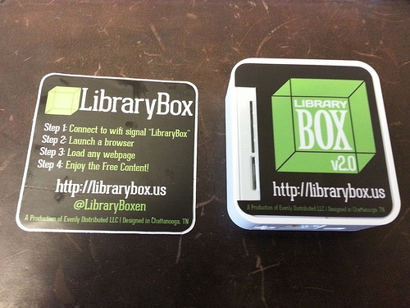
Librarybox

Slide 11
BibleBox

Slide 12
How does it work?
Turn on the BibleBox
connect device to “BibleBox files” SSID
open the web browser
browse to any http:// site and the BibleBox website will open instead
open, access, download free content
access html courses

Slide 13
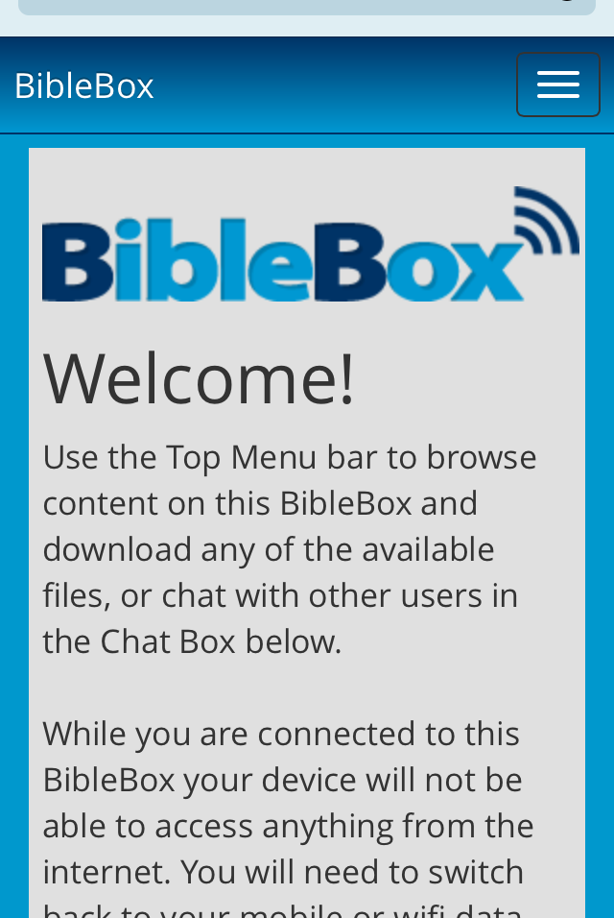
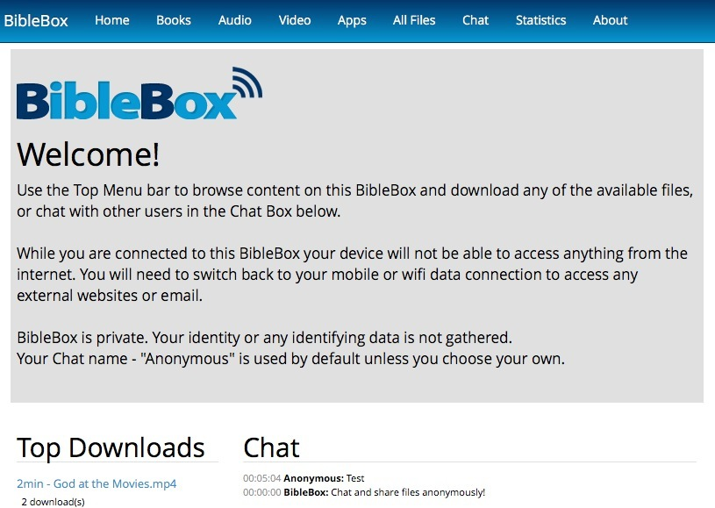
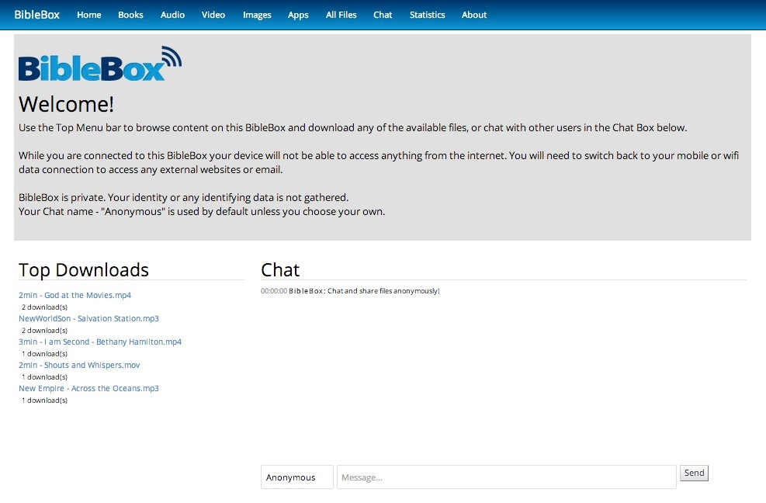
responsive web design

Slide 14
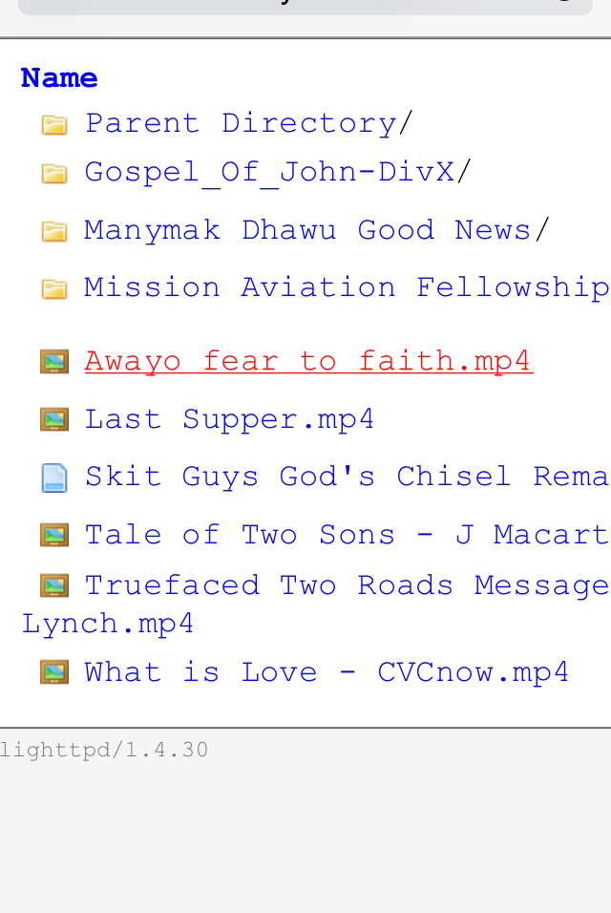
screenshots

Slide 15
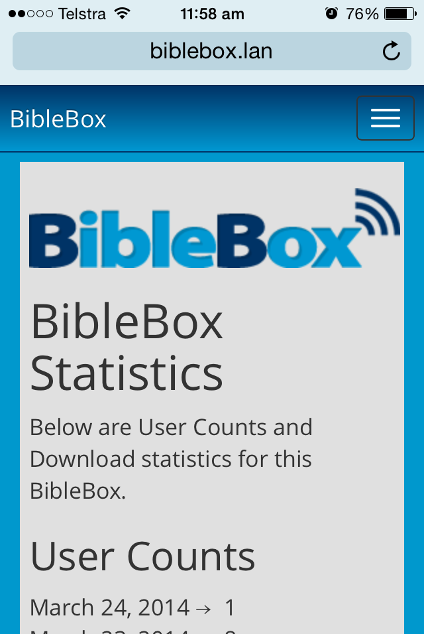
screenshots

Slide 16
mobile is personal
screen privacy
our constant companion
answer our questions
access information
digital publishing
engage with community
we share multimedia

Slide 17
sowing seeds
wifi Christian Gospel
Bible resources
wifi evangelism
wifi training
file sharing
making available

Slide 18
isolated people
limited Bible access
limited resources
security issues
no internet
remote areas
wifi devices increasing
audio visual culture
OLPC piggyback

Slide 19
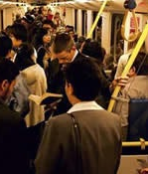
Where can I use a BibleBox?
cafe
church
on a train
in a boat
Home group
school
beach
airport
bus and bus stop
Mall
home
jungle
anywhere!

Slide 21
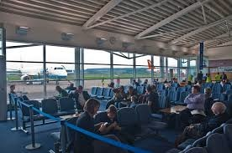
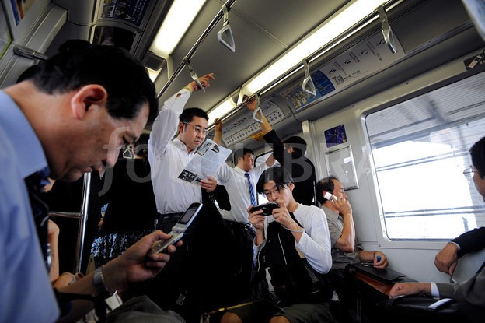
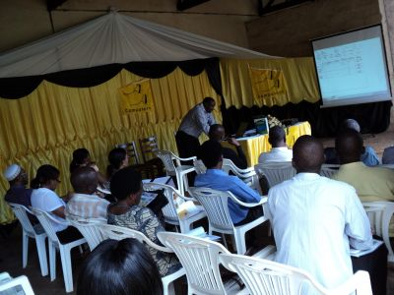
A church pastor wants his congregation to have access to a set of digital resources on a Sunday morning, but not access to the internet so that email and Facebook become distractions. He sets up a BibleBox in the church and provides access to digital resources for any wifi users.
A businessman waiting for yet another flight connects to the airport wifi to check and send his email. While he is waiting for his flight he switches on his BibleBox and makes 100′s of audio sermons available to anyone who connects to his free, secure and private BibleBox wifi.
A Christian store owner uses a BibleBox in his store to make available Christian digital resources to his customers.
A Christian in a country with limited or restricted access to Bible teaching sits in a park with her BibleBox wifi active. She can privately and securely make Bible sermons on video available to those connected to the BibleBox wifi.
An office worker on his daily commute to work on public transport uses a BibleBox on the train to make evangelistic resources available over the BibleBox wifi link to anyone who connects to it. In private.
A Christian in an apartment complex in Bangladesh uses his BibleBox to share Christian resources anonymously with others in his complex. They share resources and can even chat online using the BibleBox software out of sight to answer any questions or discuss issues.
A Christian field worker travels from the city to more remote areas of her region to meet with local church members and leaders. She takes with her a fully charged BibleBox to the various meetings where resources are made available and downloaded to Android smartphones and tablets. The church leaders and members then share them through their device with others in their local villages, making Bible teaching more available and frequent.

Slide 22
Why would I use a BibleBox?
evangelism
Bible study resources
worship
devotions
music
church resources

Slide 23
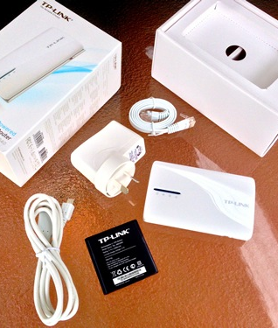
make your own
TP-Link MR3040 router
OpenWRT firmware
installation files licensed under GPLv2
www.BibleBox.org/make-your-own

Slide 24
BibleBox community
http://BibleHub.org
free or public domain resources
fill your BibleBox!
Facebook
Twitter
Google+

Slide 25
BibleBox.org
Campbell Smythe
smythec@gmail.com

